Slide 1
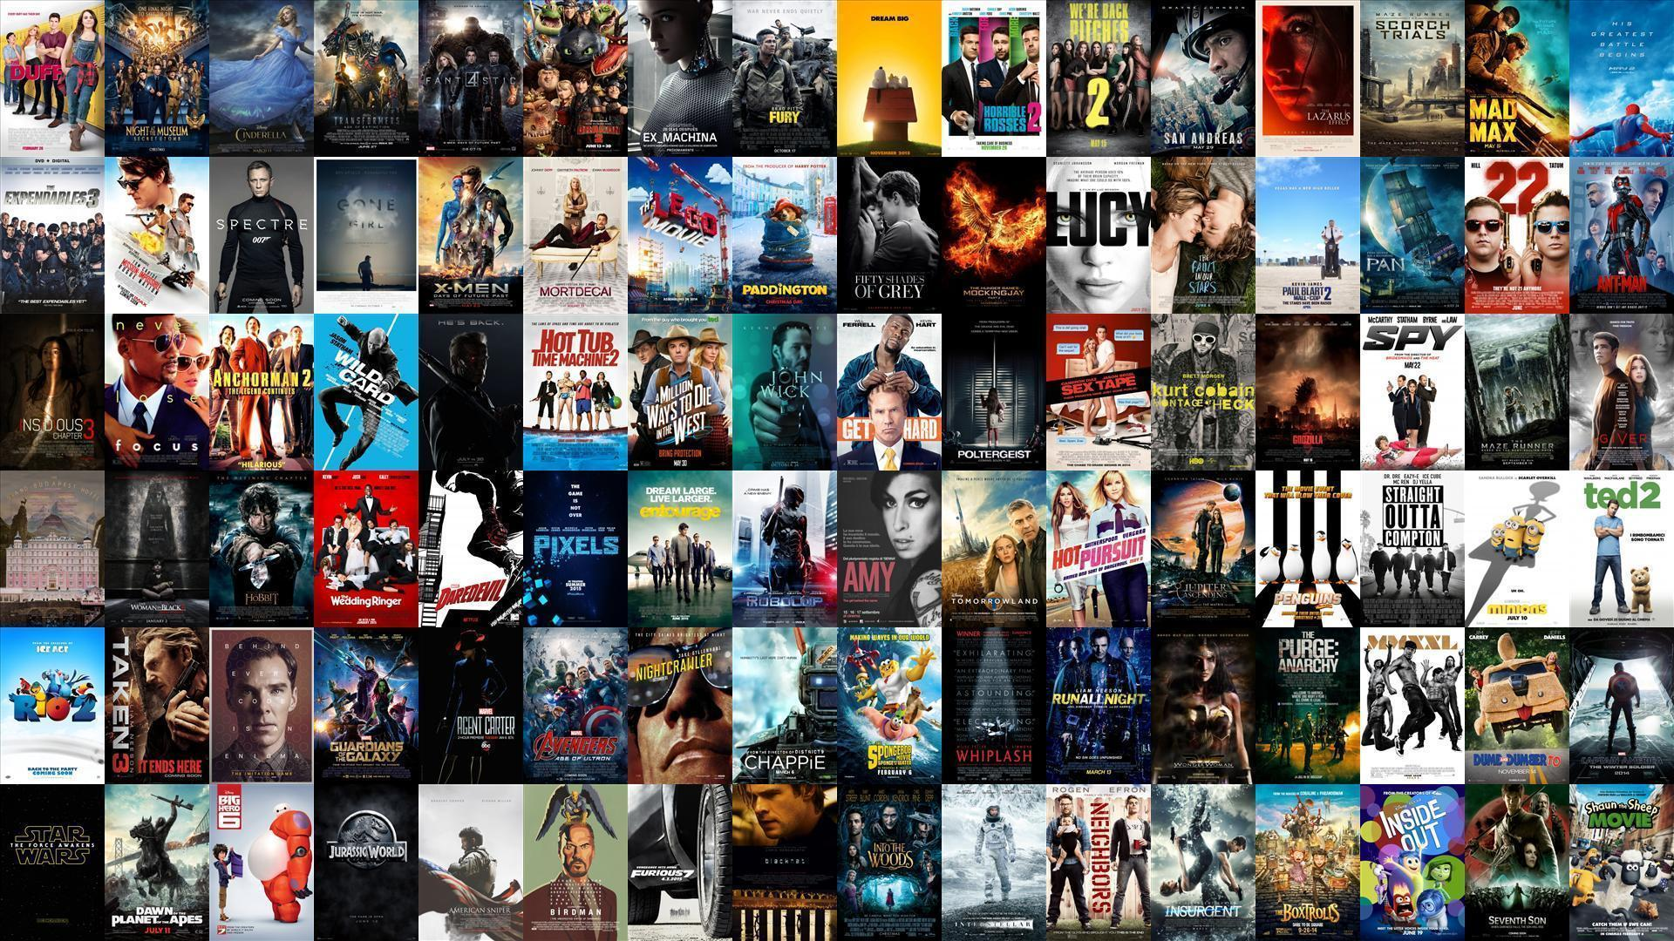
1000 MOVIES DATASET: AN EXPLORATORY DATA ANALYSIS
Presented by
SuriyaPrakash Ramraj, DS Consultancy

Slide 2

INTRODUCTION
The Film industry has undergone a lot of changes in the last few decades. There is no straightforward formula to producing a successful movie until to date.
Be it technology, production, film marketing or distribution. As a result of which, many filmmakers without the backing of a large film production house, face several challenges.
While some of them have existed for years, others have cropped up with the advent of new technology and changing consumer tastes.

Slide 3
PROBLEM STATEMENT
A new movie production company named Silverline Productions planning to produce a movie that will do best in terms of all aspects include: Revenue, Rating, Metascore, and Popularity in 2017. They also would like to growth rate of the Movie Industry
To tackle this problem, the movie production company hired a genius team of data scientists and I am one of them
The aim of this project is to recommend Silverline Productions if it is the right time to invest the money as well as suggesting the most appropriate Genre, Director, Actor, and Runtime Levels that they should consider to receive better returns.

Slide 4
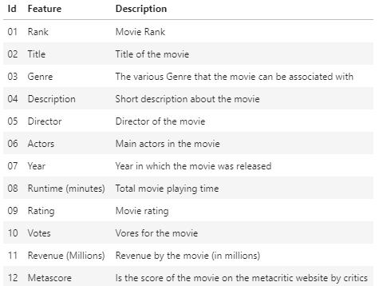
DATA DESCRIPTION

Slide 5
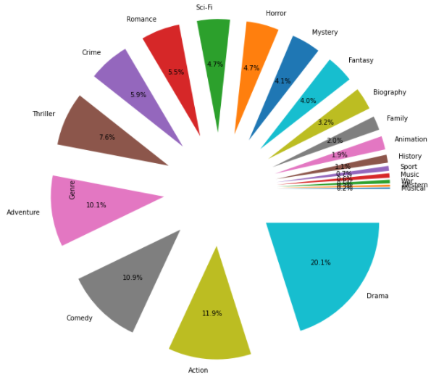
Most Popular Genres [2006-2016]
The most popular genre is Drama, which was followed by Action, Comedy, and Adventure. On the other hand, Musical, Western, War, and Music are the least popular genres

Slide 6
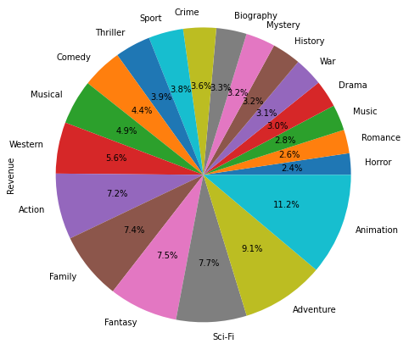
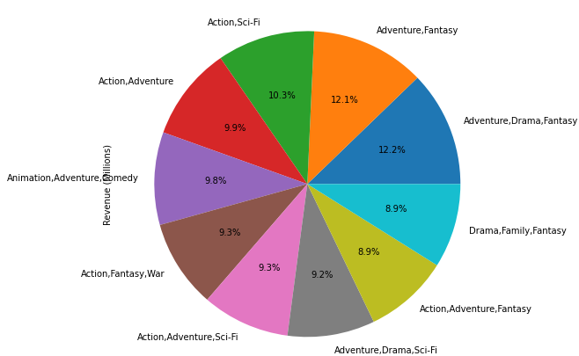
Top Genres by Revenue
Though Drama has been the most active genre between 2006 and 2016, Animation was the individual movie genre that generated maximum revenue, which was followed by Adventure, Sci-fi, and Fantasy
It has also been discovered that the combination of multiple genres such as Action, Adventure, Fantasy, and Sci-Fi generated exorbitant revenues

Slide 7
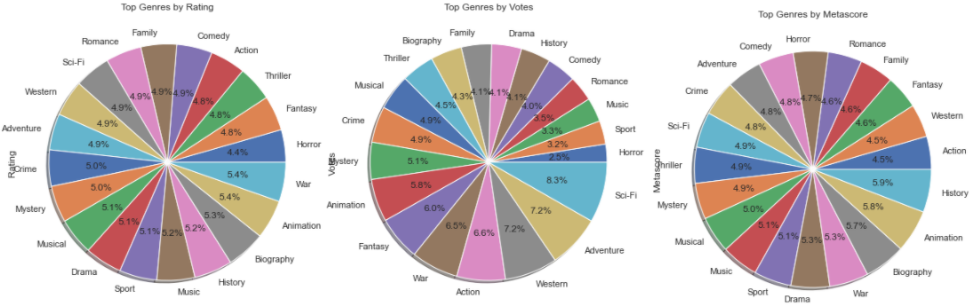
Top Genres by Rating
Animation, War, Biography, and History are the genres that are most critically acclaimed by both viewers and critics

Slide 8
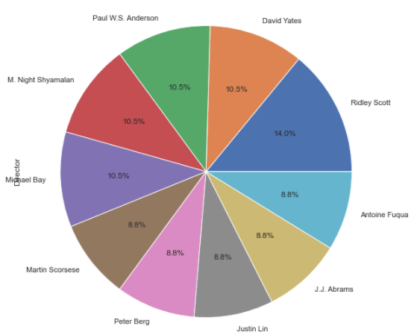
Most Active/Popular Directors [2006-2016]
Ridley Scott has been the most active director who directed 8 movies. He was followed by David Yates, Paul W.S. Anderson, M. Night Shyamalan, and Michael Bay

Slide 9
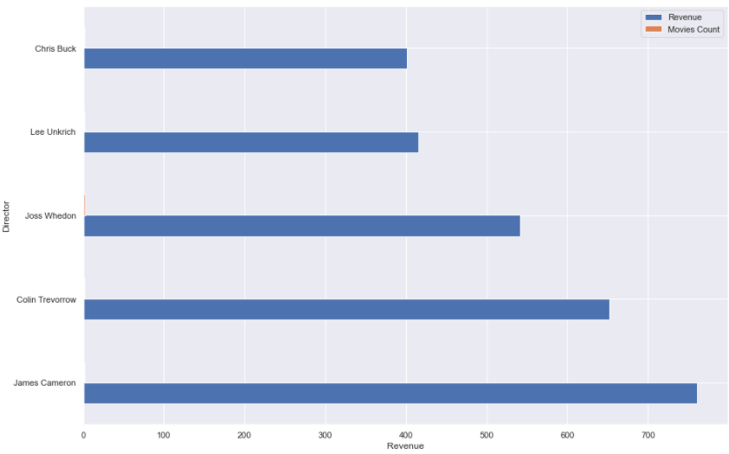
Top 5 Directors By Revenue
James Cameron is the director who directed the movie that generated maximum revenue, which is Avatar. He was followed by David Yates, Paul W.S. Anderson, M. Night Shyamalan, and Michael Bay

Slide 10
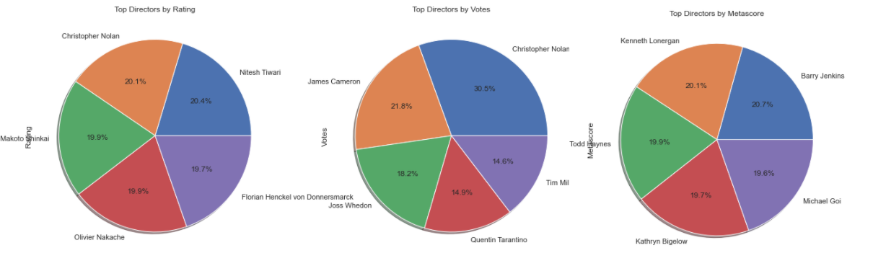
Top 5 Directors By Ratings
Christopher Nolan is the director who was well received by viewers. This is because of the extra-ordinary movies directed by him in this period include: The Prestige, The Dark Knight, Inception, The Dark Knight Rises, and Interstellar
Critics liked Barry Jenkins's movies the most. He is closely followed by Kenneth Lonergan and Todd Haynes

Slide 11
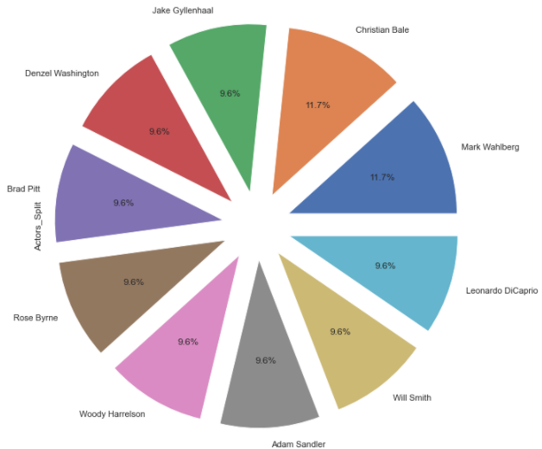
Most Active/Popular Actors [2006-2016]
Mark Wahlberg and Christian Bale are the most active actors between 2006 and 2016

Slide 12
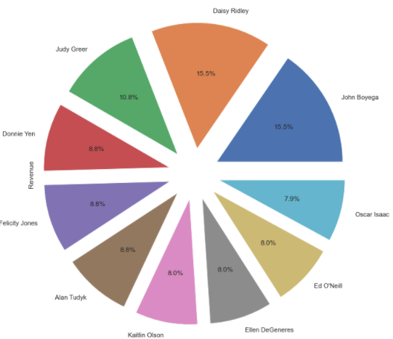
Top 10 Actors By Revenue
John Boyega and Daisy Ridley are the actors who acted in the movie that generated maximum revenue, which is Star Wars: Episode VII The Force Awakens. They are followed by Judy Greer

Slide 13
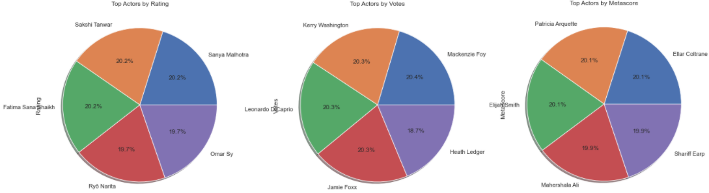
Top 5 Actors By Ratings
Mackenzie Foy is the actor who was well received by viewers. Other prominent actors include: Leonardo DiCaprio, Kerry Washington, Jamie Foxx, and Heath Ledger
Critics liked Ellar Coltrane, Patricia Arquette, and Elijah Smith the most

Slide 14
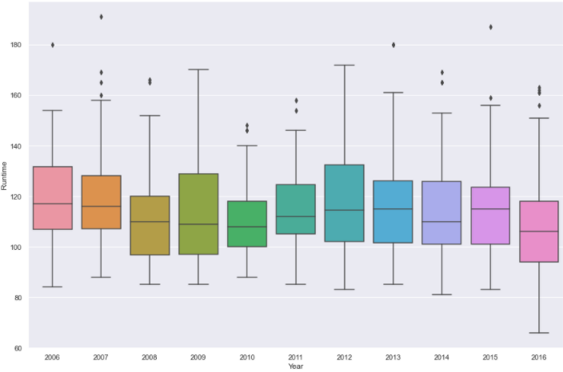
Movie Runtime Trends [2006-2016]
The average runtime of movies has decreased throughout the years. 2010 is the year with movies longer runtime.
Notably, 2016 has movies with shortest runtimes due to the short movies' releases and this is one notable trends to keep an eye on.

Slide 15
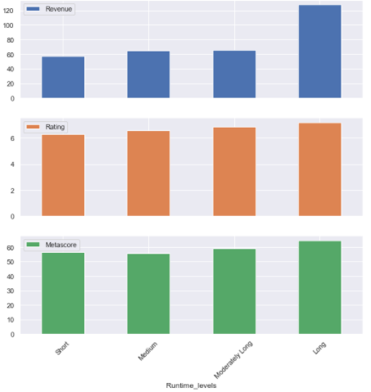
Best Runtime Levels by Revenue & Ratings
Undoubtedly, Movies with longest runtime generated higher revenue when compared to Short, Medium, and Moderately Long movies.
On the other hand, though Movies with longest runtime were critically acclaimed slightly higher than other categories, there is no interesting trend in terms of runtime Vs. movie rating.

Slide 16
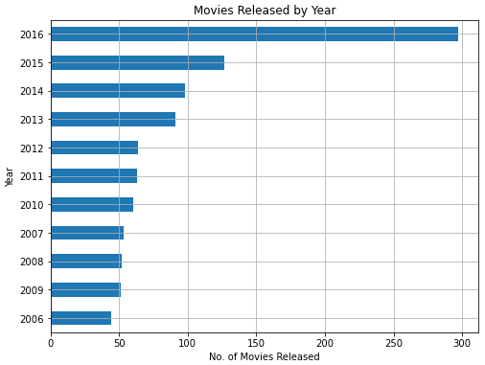
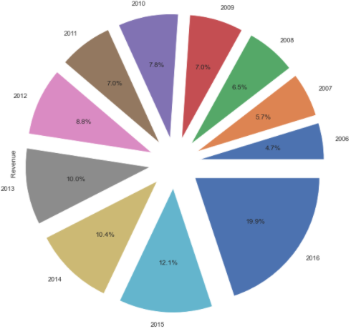
Movie Industry Growth
Remarkably, there is an increasing trend in terms of number of movies released every year. 2016 has seen an exorbitant rise and this may likely because of the Short Films
Notably, there is an increasing trend in terms of revenue growth

Slide 17
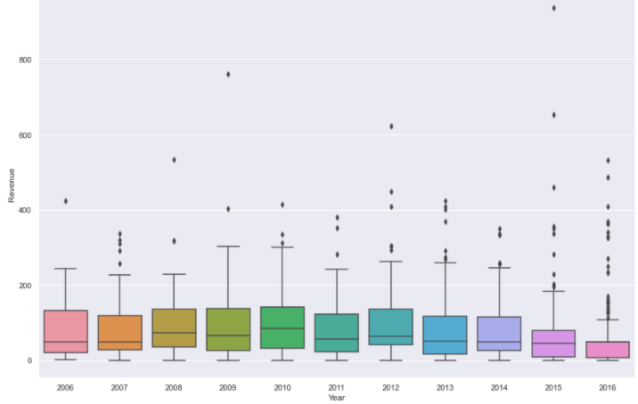
Average Revenue Vs. Overall Revenue
The average revenue of the movie industry is not aligned with the overall revenue growth trends and is experiencing the downward trend
2010 is the most successful year; 2016 is the least successful year, which is a trend to worry about.

Slide 18
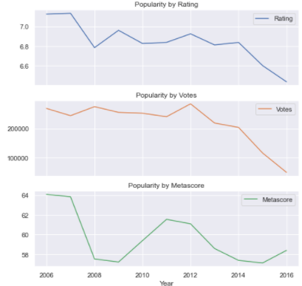
Movie Industry Popularity [2006-2016]
Despite increase in the movie industry's overall revenue, the average rating scores of movies is plummeting from 2017 and is experiencing a severe downward trend expect in the year 2012.
This trend questions the quality of movies released in the recent past.

Slide 19
ACTIONABLE INSIGHTS
Based on the insights acquired from the exploratory data analysis, below are the some actionable insights for Silverline Productions to produce a successful movie in 2017 as follows:
Multiple Genres
It is evident that it is very evident that the combination of genres such as Action, Adventure, Fantasy, and Sci-Fi generated exorbitant revenues. Silverline Productions must produce a movie fitting the above multiple genres to reap maximum benefits
Using Active/Critically Acclaimed Directors
Silverline Production can consider any of the active/critically acclaimed directors for its movie. This will maximize the chances of earning more Revenue, Rating and Metascore.
Movies with Long Runtimes
They must consider producing a movie with runtime more than 123 Minutes
Keeping Multiple Audiences in Mind
Silverline Productions must produce movies that will satisfy both viewers and critics in order to maximize the chances of earning more Revenue, Rating and Metascore.

Slide 20

Thanks For the Opportunity!!!

